Slide 1
GTTT-107 – Assign Deputy Analysis
TCoE, DevOps, BPM and Guidewire Team

Slide 2
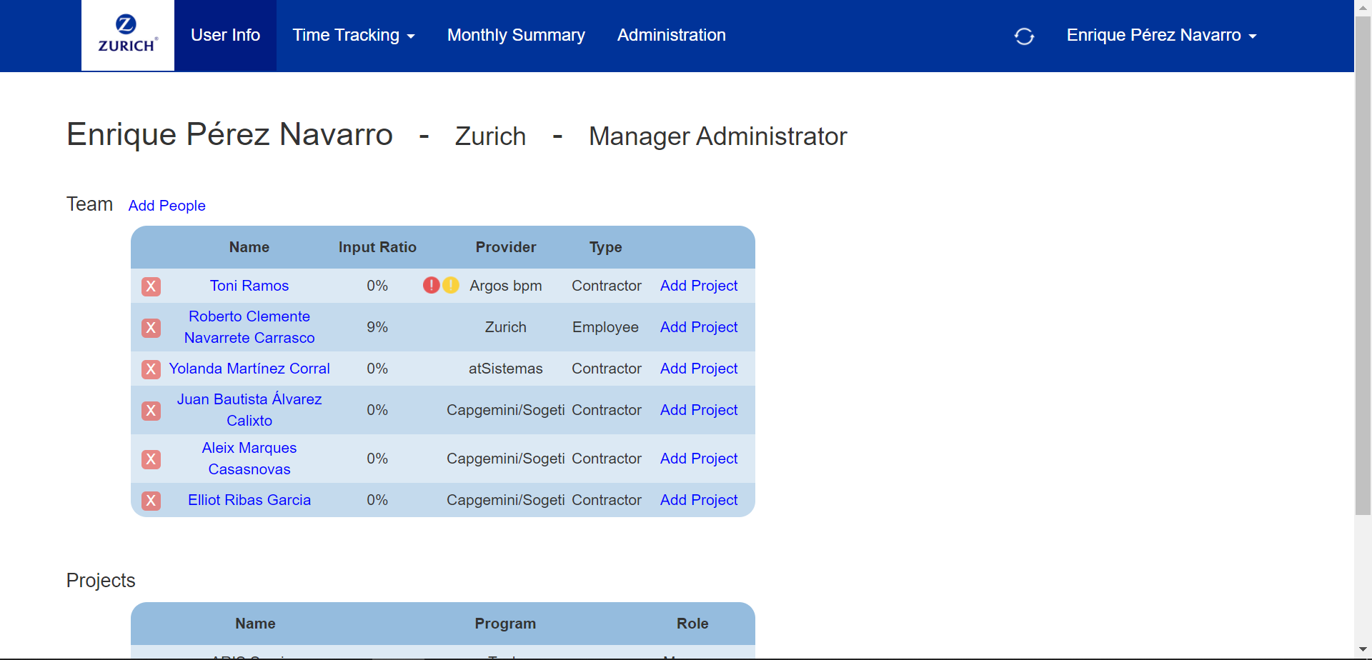
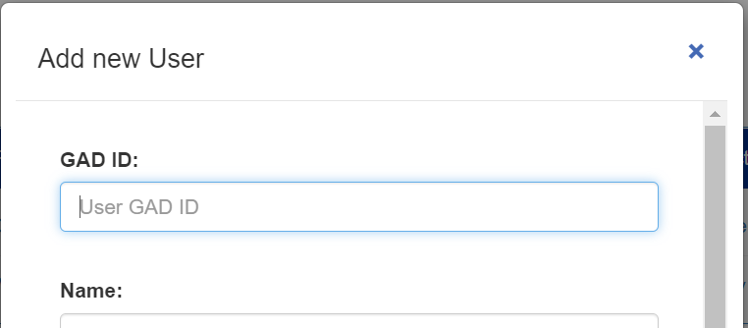

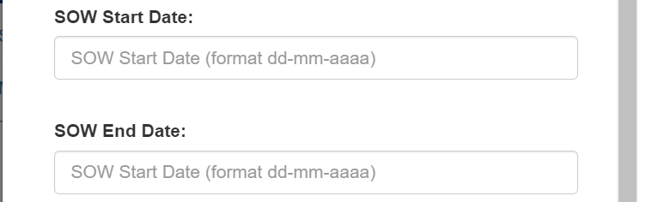
Assign Deputy from User Info Screen
New Link
Link to open ‘User Selection’ floating window: similar to the User Creation window in Administration.
Floating window containing User Name text box, Start Date, End Date, Assign and Cancel.
Assign Deputy
Assign Deputy
- Only users with a Manager role will be listed.
- ‘Assign’ button displays a confirmation warning: ‘Are you sure you want to activate a Deputy role?’
Deputy Start Date
Deputy End Date
Assign

Slide 3
Deputy assignment outcome for Manager
Remove Deputy
Link to open a confirmation message.
Alternatively, Deputy assignment is automatically removed after the selected period expires.
NOTE: During the deputy assignment, the manager is still able to operate over his/her team.

Slide 4

Deputy assignment outcome for Deputy
Deputy Name
Assign Deputy
Deputy assignment only affects Deputy’s direct team.
NOTE: Deputy is not allowed to remove people from another team or to add new projects to them.

Slide 5
Additional Notes / Questions
Team members from the ‘source’ manager will be available for Deputy in ‘Record Time’, ‘Approve Time per Month’, ‘Approve Time per Week’ and ‘Monthly Summary’ screens.
Do we need to send an email to the assigned Deputy once the assignment is active?
Do we need an ‘Active Deputy Assignments’ report in Administration?
How should we handle ‘Deputy’ report? As a separate report in Monthly Summary? (In this case, as a link only visible if Deputy assignment is active). Or assigned Team Members should appear in the regular Team report?

